Slide 1
Difference between real-time and streaming systems
Pravin Y Pawar

Slide 2
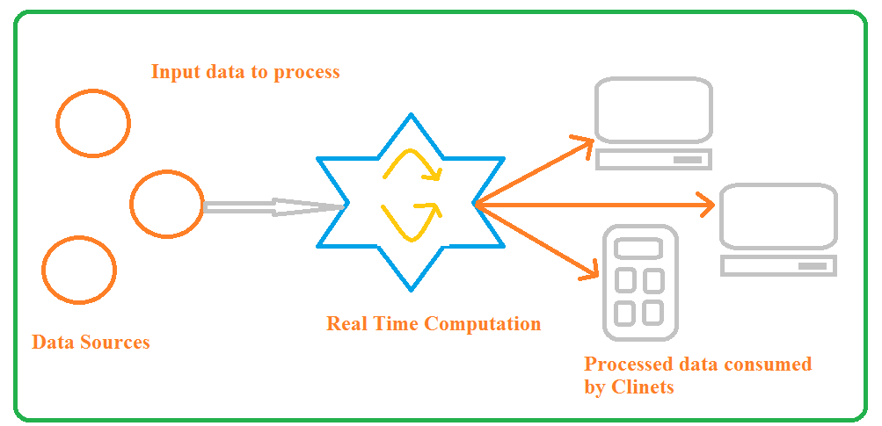
Real-time systems again
Soft or near real time systems
Based on the delay experience by consumers – soft or near real time systems
Difference between them is blurring , hard to distinguish
Two parts are present in larger picture
Source : Adapted from Streaming Data by Andrew Psaltis

Slide 3
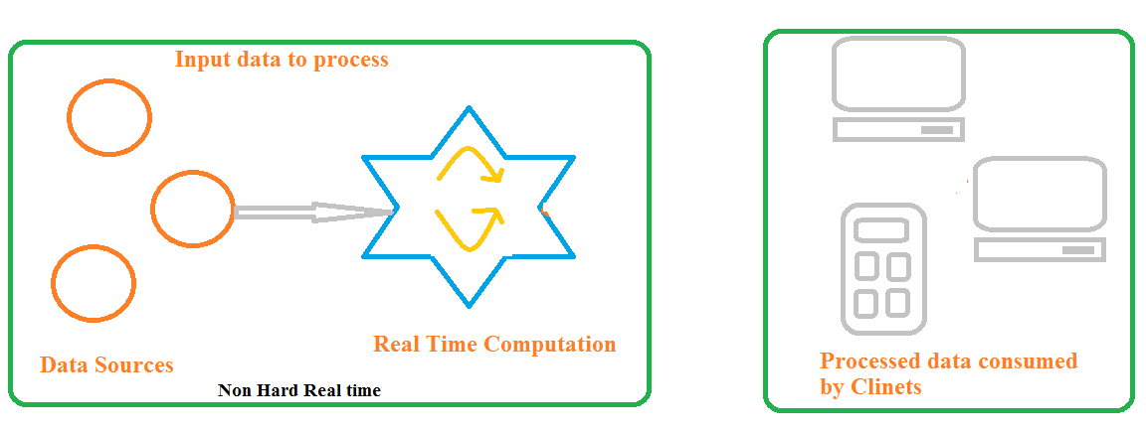
Breaking the real time system
Lets divide the real time system into two parts
Left part Non-hard real-time system
Right part client consuming data
Source : Adapted from Streaming Data by Andrew Psaltis

Slide 4
Streaming Data Systems
Defined
Computation part of real time system operating in non-hard real-time manner
But Client not consuming the processed data
Due to network issues, application requirement, no application running
Clients consume data when they need it
Streaming data system
Non-hard real time system with clients that consume data when they need it

Slide 5
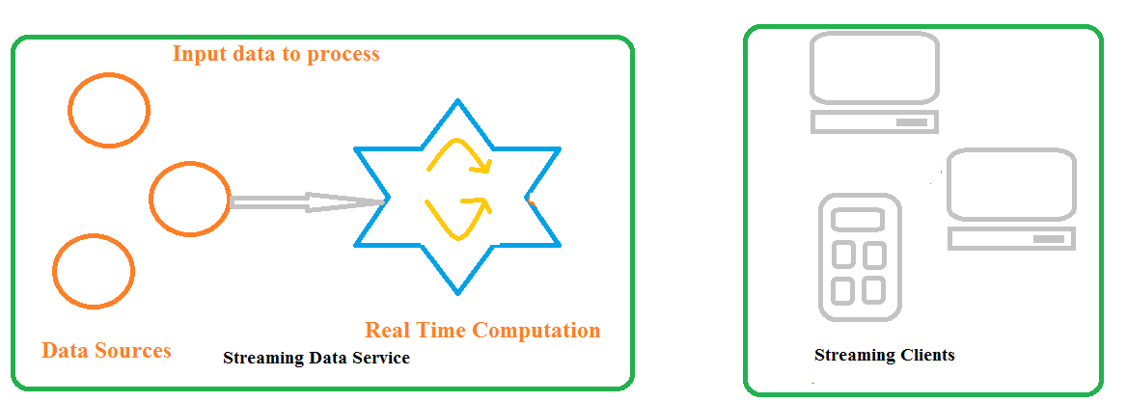
First view of Streaming Data System
Source : Adapted from Streaming Data by Andrew Psaltis

Slide 6
Streaming Data Systems(2)
Examples revisited
Lets divide the earlier discussed examples into two parts and identify the streaming part of it
Twitter
A streaming system that processes tweets and allows clients to request the tweets when needed
Flight Tracking System
A streaming system that processes most recent flight status data and allows client to request the latest data for particular flight
Real time Quotes Tracking System
A streaming system that processes the price quotes of stocks and allows clients to request the latest quote of stock

Slide 7
Thank You!
In our next session: Difference between batch processing and stream processing

